Slide 1
Multilabel French Text Classification
Data Challenge
Presented by:
Ayoub Youssoufi
Hatim Alouane
Yasser Zidani

Slide 2
Data processing
performing tokenization in the input data to get a list of tokens
Stop words removal
Reducing the word forms with Stemming
Text normalization
Feature extraction with TF-IDF

Slide 3
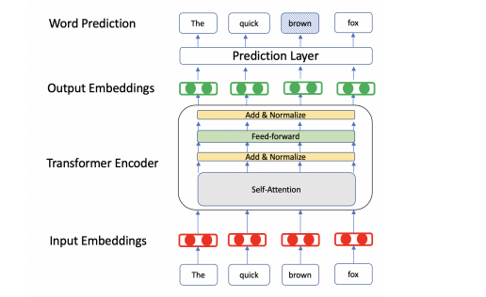
Model : Camembert :

Slide 4
Optimisation of parameters :
To improve the model performance :
Learning rate
Batchsize
Length of the embedding inputs
Reduce the gap between training loss and validation accuracy

Slide 5
Results & interpretation :
We achieved an accuracy score of :
The highest proportion in Xtest is Category3 as in training : Meaning that the majority of responders are having more interest in economy
Almost Equality between Category2 & Category1 but a preference for Category1: Meaning that in the second place AFTER responders interest for Economy, they are interested in themselves, and then for the others.
The minimalist proportion was for Category4 : Meaning that people who are indifferent are minimalist in term of proportion.

Slide 6


